Slide 1
Ecological Model
Describing the
Inter-relations of
the Natural World.

Slide 2
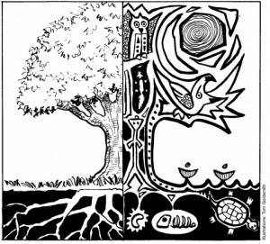
Native Science
Native Cultures emphasized the relationship between things in nature.
Developed basic
Natural Laws
  All living things are interconnected.
  The natural world is in a constant state of change.
  Understanding change (rather than controlling it) can give humans power while maintaining balance.

Slide 3
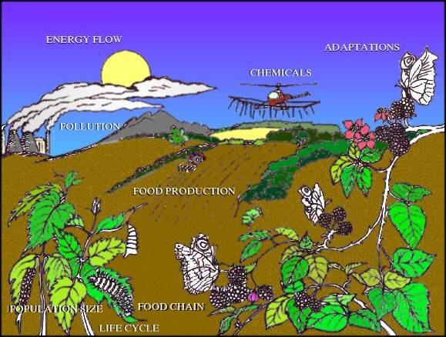
Ecology
Ecology:
Study of the interactions of living organisms with one another and with their physical environment.

Slide 4
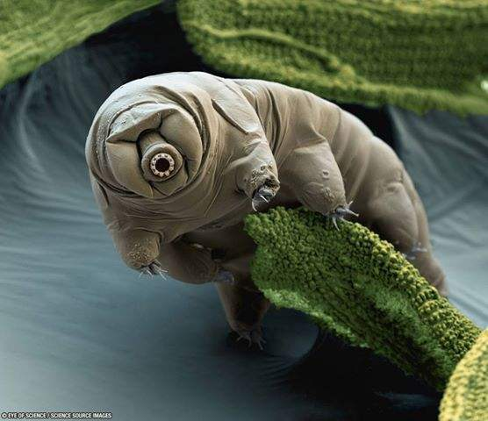
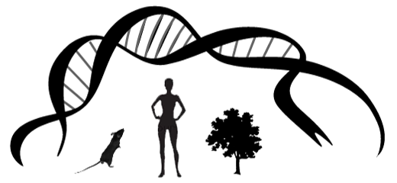
Organism
Organism: Defined as something that meets the criteria for a “living thing”.
Criteria:
  Has genetic material
  Is made up of one or more cells.
  Uses energy
  Reproduces
  Others.

Slide 5
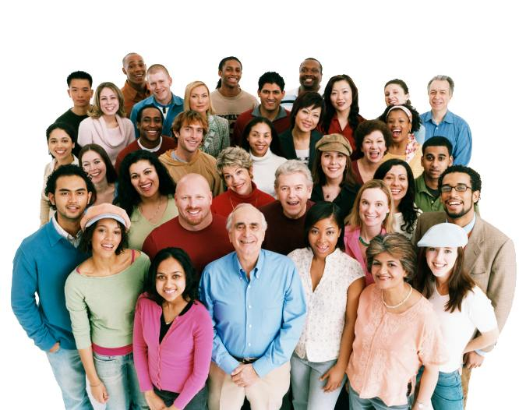
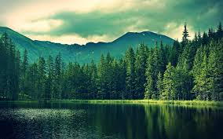
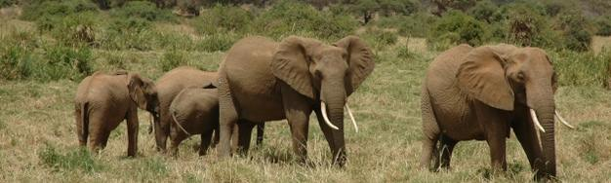
Population
Population: is a group of organisms of the same species living together in the same place and interbreeding.

Slide 6
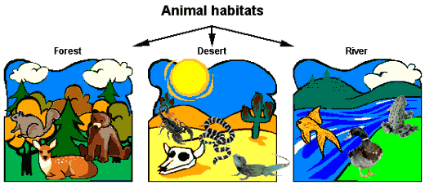
Habitat
Habitat: the place where a particular population of a species lives.

Slide 7
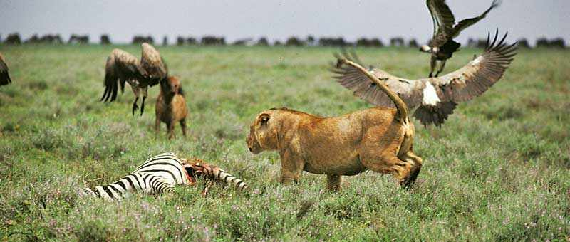
Community
Community: In biology, a community is when different populations (species) live together in a habitat.

Slide 8
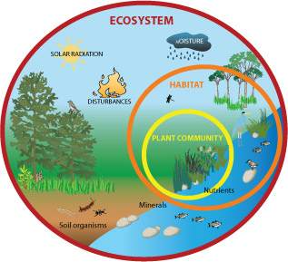
Ecosystem
Ecosystem: consists of a community and all the physical aspects of its habitat (such as soil, water, weather)
Also called: Ecological System

Slide 9
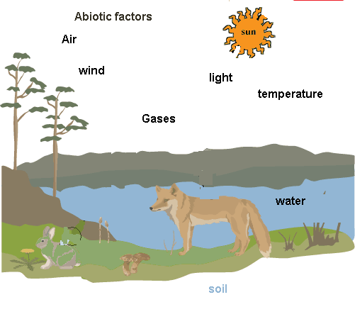
Biotic and Abiotic Factors
An ecosystem has factors: things that affect it. 2 types:
Biotic factors: the organisms in the habitat.
Abiotic factors: the non-living things that affect the ecosystem such as: physical structures, water, soil, etc.

Slide 10
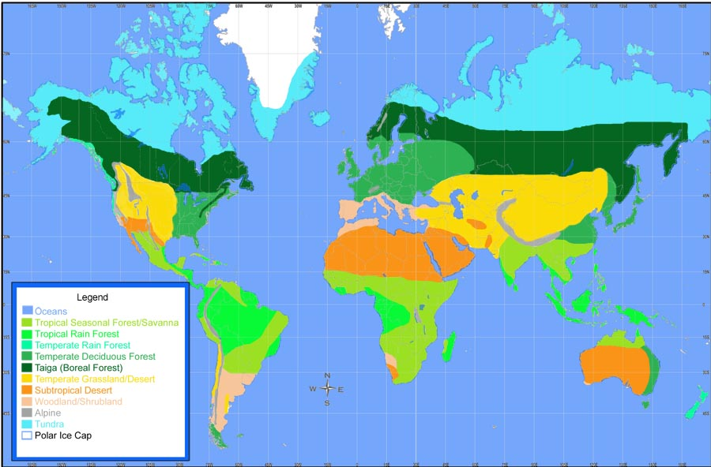
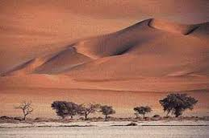
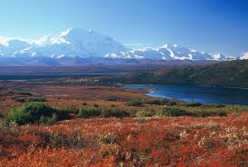
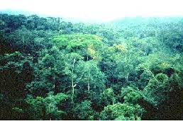
Biome
Biome: is what you call a major community or communities over a large area.

Slide 11
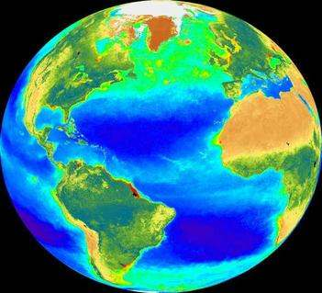
Biosphere
Biosphere: is the sum of ecosystems that make up the earth.
  Closed system (apart from sun & inside the earth)
  Self-regulating: controls itself.

Slide 12
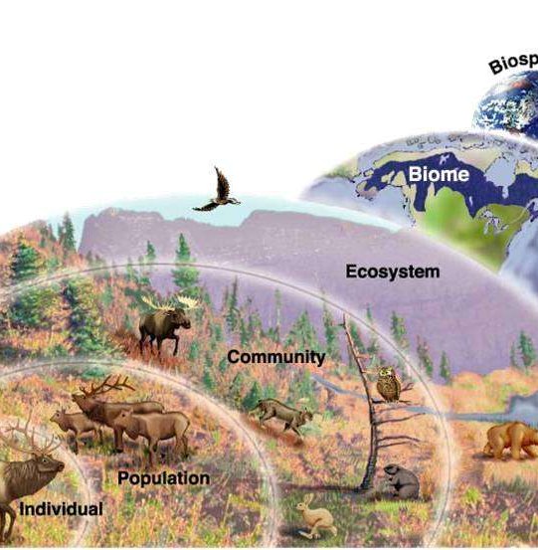
Ecological Model
Ecological Model:
Is a picture we can use on how an organism is inter-related to the living and non-living things around them.

